Slide 1
Chapter 10
Transaction Management and Concurrency Control

Slide 2
In this chapter, you will learn:
What a database transaction is and what its properties are
How database transactions are managed
What concurrency control is and what role it plays in maintaining the database’s integrity
What locking methods are and how they work
How database recovery management is used to maintain database integrity

Slide 3
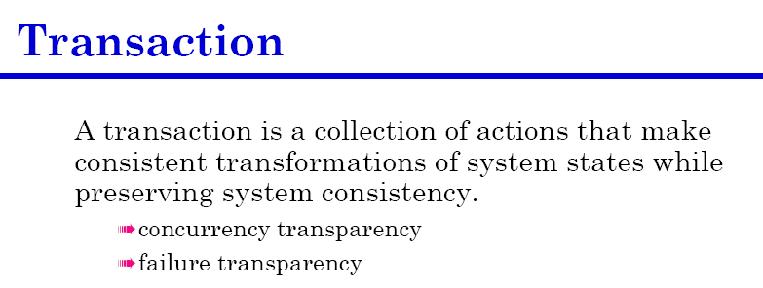
What is a Transaction?
Read from or write to a database, create a transaction.
It can be a single SQL command or series of related commands
In practical, transactions are formed by two or more database requests
Database request is the equivalent of a single SQL statement
Notes:
4

Slide 4
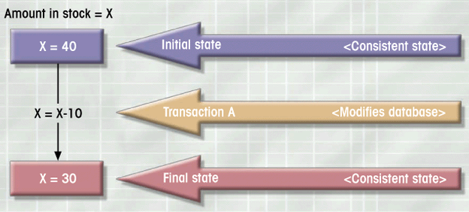
What is a Transaction?
Logical unit of work
Must be either entirely completed or aborted
No intermediate states are acceptable
Figure 9.1
Notes:
4

Slide 5
What is a Transaction?
Transaction changes the contents of the database must alter the database from one consistent state to another.
Consistent database state is one in which all data integrity constraints are satisfied.
All transactions are controlled and executed by the DBMS to guarantee database integrity.
Notes:
4

Slide 6
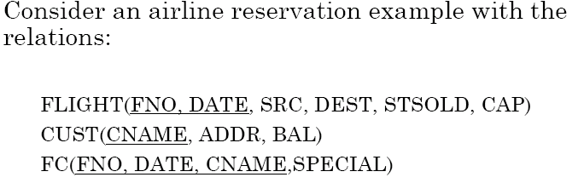
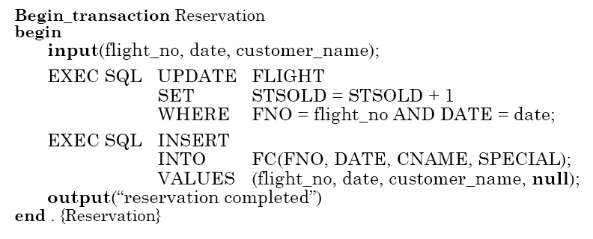
Transaction Example
Notes:
4

Slide 7
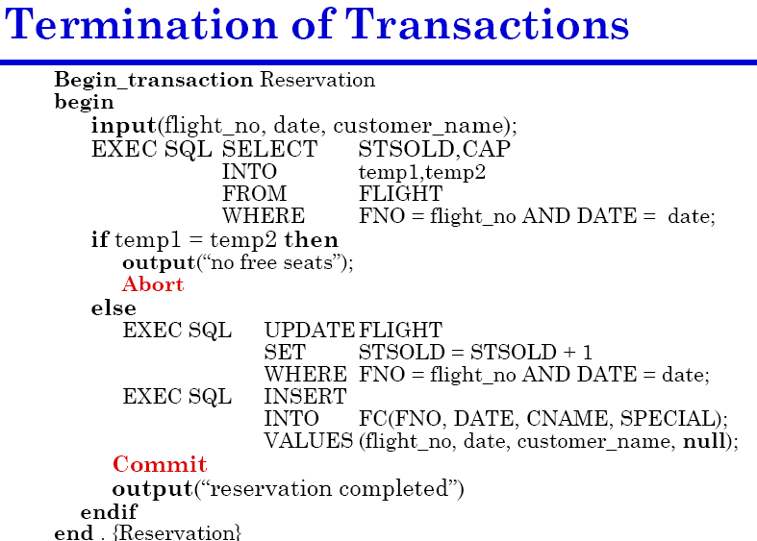

Slide 8
Example Transaction
Register credit sale of 100 units of product X to customer Y for $500
  Reduce product X’s quantity by 100
  Adding $500 to customer Y’s account receivable
UPDATE PRODUCT
SET PROD_QOH = PROD_QOH - 100
WHERE PROD_CODE = ‘X’;
UPDATE ACCT_RECEIVABLE
SET ACCT_BALANCE = ACCT_BALANCE + 500
WHERE ACCT_NUM = ‘Y’;
Notes:
6

Slide 9
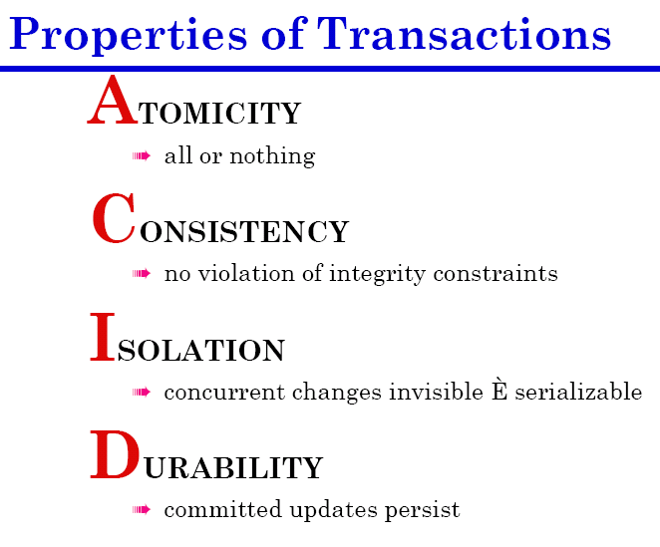

Slide 10
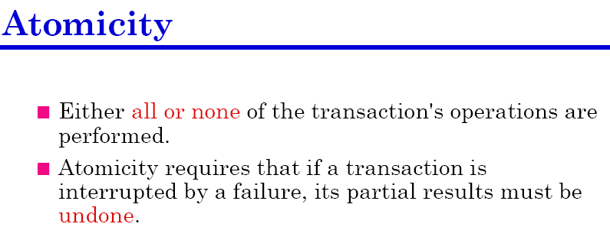
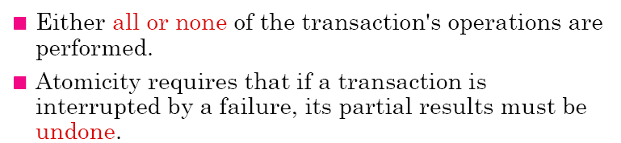

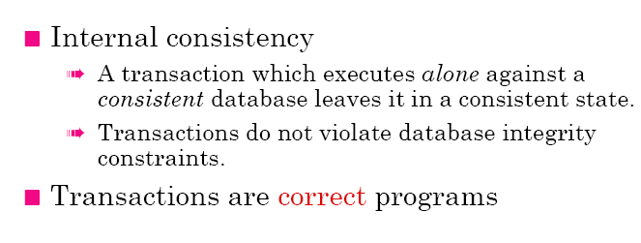
Transaction Properties
Notes:
6

Slide 11
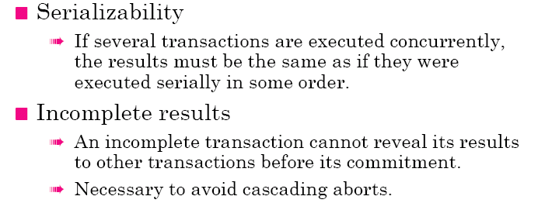
Transaction Properties

Slide 12
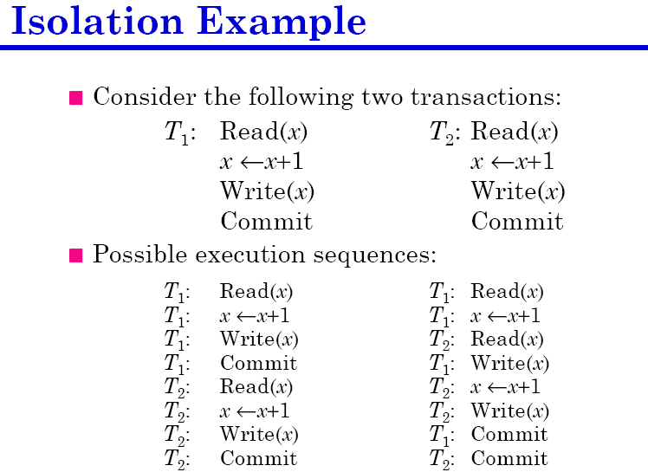

Slide 13
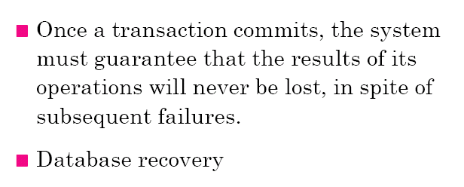
Transaction Properties
Notes:
9

Slide 14
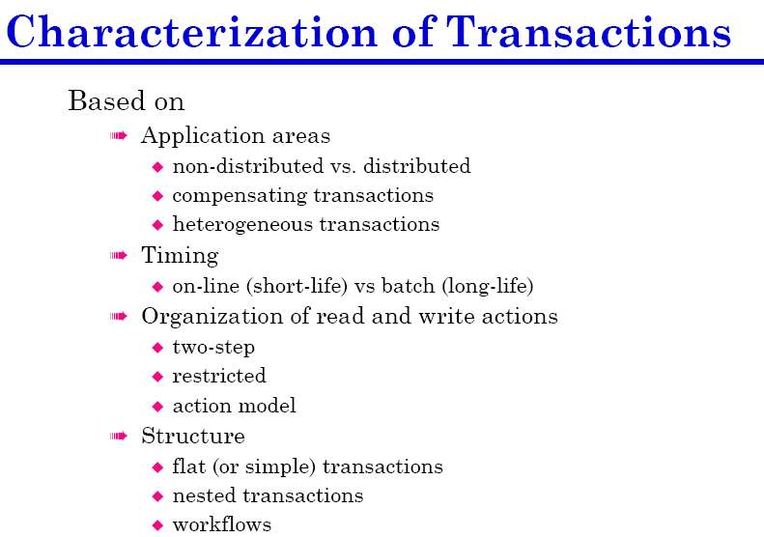
Notes:
10

Slide 15
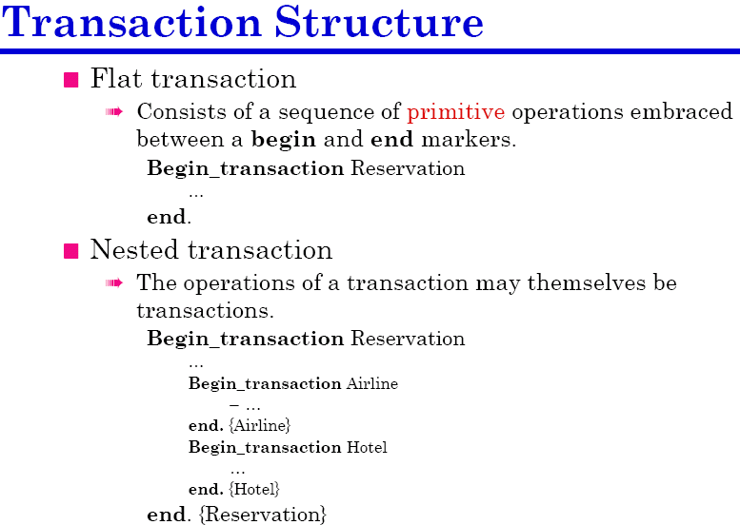
Notes:
10

Slide 16
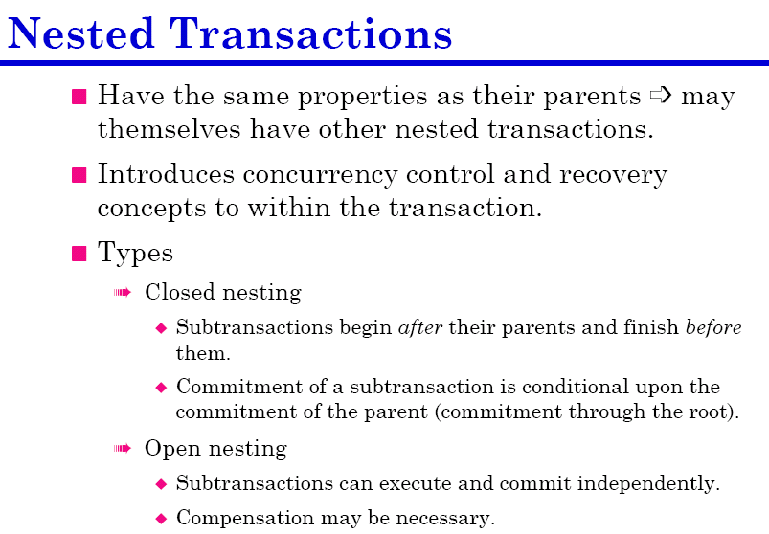

Slide 17

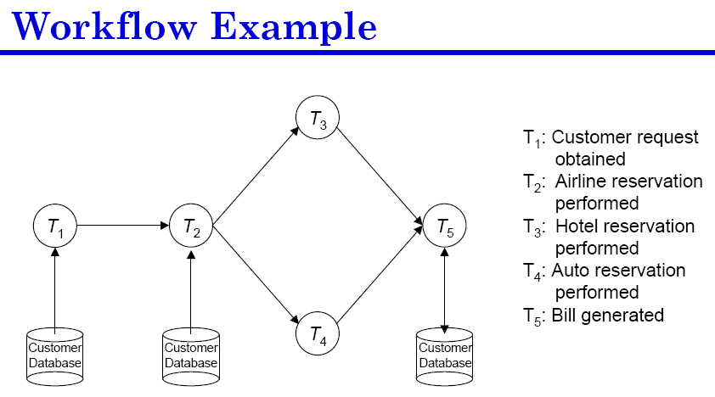

Slide 18
Concurrency Control
Coordinates simultaneous transaction execution in multiprocessing database
  Objective of concurrent control is to ensure serializability of transactions in multi-user database environment
  Simultaneous execution of transactions over a shared database can create several problems in data integrity and consistency.
  Potential three problems in multi-user environments
    Lost updates
    Uncommitted data
    Inconsistent retrievals
Notes:
14

Slide 19
Concurrency Control
Lost updates
  Observation of PRODUCT table (PROD_QOH as a attribute), current value is 35
  Two transactions occur (T1 and T2)
T1: purchase 100 units → PROD_QOH= PROD_QOH+100
T2: sell 30 units → PROD_QOH= PROD_QOH-30
Notes:
14

Slide 20
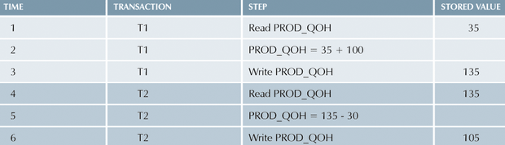
Lost Updates
If transaction T2 also reads the original value, we have the following case: T1 has not yet been committed when the T2 is executed.

Slide 21
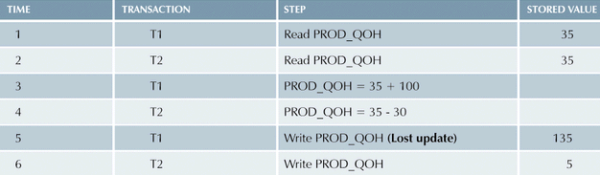
Lost Updates

Slide 22
Uncommitted Data
During two transactions, T1 and T2 are executed concurrently and T1 is rollback after the T2 has already accessed the uncommitted data
Example: T1 rollback to eliminate adding 100 units
T1: purchase 100 units → PROD_QOH= PROD_QOH+100 (rollback)
T2: sell 30 units → PROD_QOH= PROD_QOH-30
Notes:
14

Slide 23
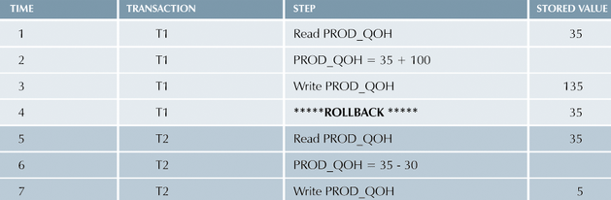
Uncommitted Data

Slide 24
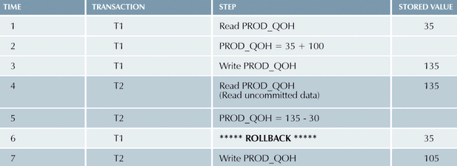
Uncommitted Data
Uncommitted data problem can arise when the ROLLBACK is complete at T2 has begin its execution.

Slide 25
Inconsistent Retrievals
Occur when a transaction calculates some summary functions over a set of data while other transactions are updating the data.
T1: calculates the total quantity on hand
T2: at the same time updates the quantity fro two of PRODUCT table’s product
Notes:
14

Slide 26
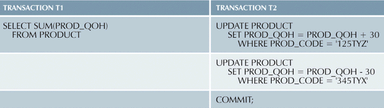
Inconsistent Retrievals
Objective: user accidentally added 30 to 345TYX PROD_CODE. We need to correct it. Suppose to add to 125TYZ. ---- Jun Ni’s mistake he made!
He promised to correct. Watch what he did!

Slide 27
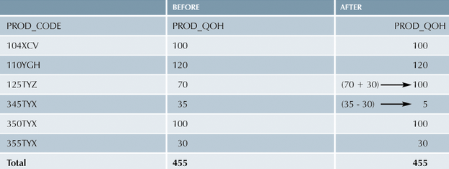
Inconsistent Retrievals
Table 9.7

Slide 28
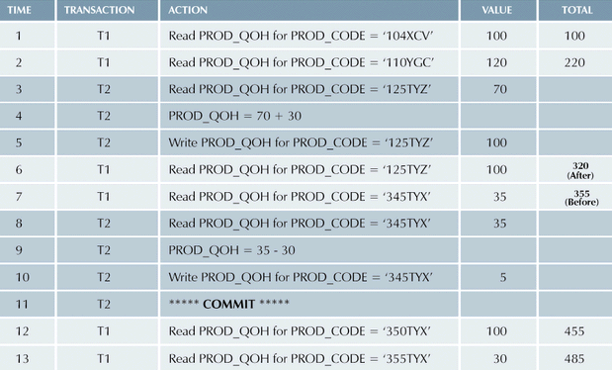
Inconsistent Retrievals (con’t.)
Table 9.8

Slide 29
The Scheduler
How is the correct order? Who determines the order?
Fortunately, DBMS handles that tricky assignment for us by using a built-in scheduler
Scheduler establishes order of concurrent transaction execution
Notes:
23

Slide 30
The Scheduler
Interleaves execution of database operations to ensure serializability
Bases actions on concurrency control algorithms
  Locking
  Time stamping
Ensures efficient use of computer’s CPU
  No scheduling, make transaction first comes first
  Lost CPU cycles during processing of I/O
Notes:
23

Slide 31
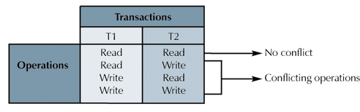
Read/Write Conflict Scenarios:
Conflicting Database Operations Matrix
Table 9.9

Slide 32
Concurrency Control with Locking Methods
Lock guarantees current transaction exclusive use of data item (T2 does not have to access to the data item that currently being used by transaction t1)
Acquires lock prior to access
Lock is released (unlocked) when transaction is completed. So other transactions can lock the data
Notes:
25

Slide 33
Concurrency Control with Locking Methods
DBMS automatically initiates and enforces locking procedures
Managed by lock manager (built-in DBMS), which is responsible fro assigning and policing the locks used by the transactions
Lock granularity indicates level of lock use
Notes:
25

Slide 34
Lock Granularity
Lock granularity indicates level of lock use
Locking can take place at the following levels:
  Database
  Table
  Page
  Row
  Even field (attribute)
Notes:
25

Slide 35
Database-Level Locking Sequence
A complete entity database is locked
Preventing the use of any tables in the database by transaction T2 while transaction t1 is being executed.
Good for batch processes
Unsuitable for online multi-user DBMSs (it waits for previous transaction to be completed before execution of next transaction)
Notes:
25

Slide 36
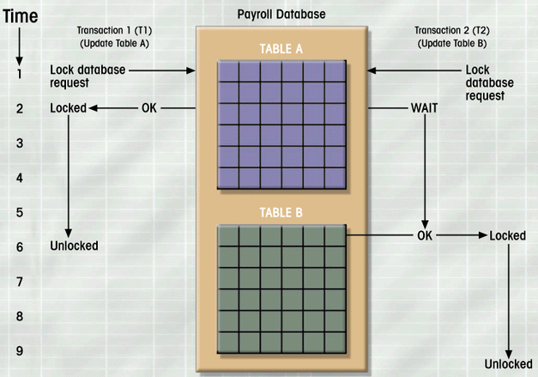
Database-Level Locking Sequence
Figure 9.2

Slide 37
Table-Level Locking Sequence
A entire table is locked
Preventing access to any row by transaction T2 while transaction t1 is using the table.
Less restrictive than database locks
Not suitable for multi-user DBMSs
Notes:
25

Slide 38
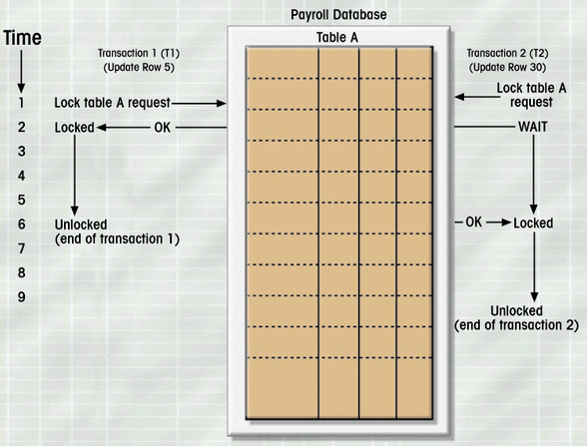
Table-Level Lock Example
Figure 9.3

Slide 39
Page-Level Locking Sequence
Lock an entire diskpage, page (equivalent of a disklock, described as a referenced section of a disk.
A table can span several pages
Each page contains several rows of one or more tables
Page-level locks are currently the most frequently used multi-user DBMSs locking method
Notes:
25

Slide 40
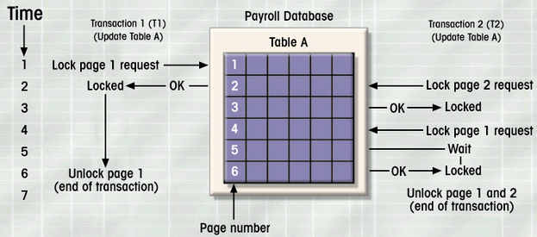
Page-Level Lock Example
Figure 9.4
If T2 wants to access the page locked by T1,
T2 must wait until T1 the page is unlocked by T1

Slide 41
Row-Level Locking Sequence
Much less restrictive than the locks discussed above
DBMS allows concurrent transactions to access different rows of the same table, even if the rows are locked on the same page.
Management requires high overhead cost
Notes:
25

Slide 42
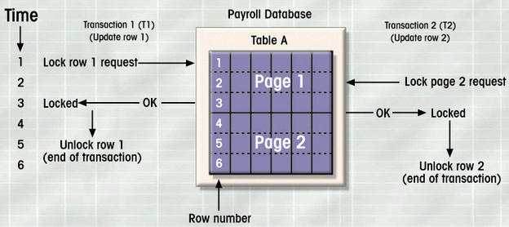
Row-Level Lock Example
Figure 9.5

Slide 43
Field (attribute)-Level Locking Sequence
Allows concurrent transactions to access the same row, as long as they require the use of different fields (attributes) within the row.
Most flexible multi-data access, it is rarely done because it requires an extremely high level of computer overhead.
Notes:
25

Slide 44
Lock Types: Binary Locks and Shared/exclusive clocks
Binary locks
  Two states
    Locked (1)
    Unlocked (0)
  Transaction must unlock the object after its termination
  Automatically managed or scheduled by DBMSs
  User does not need to concerned about locking or unlocking data items
  Override the default, one can use LOCK TABLE or other SQL commands
Notes:
31

Slide 45
Lock Types
Binary Locks and
  Locked objects unavailable to other objects
    Unlocked objects open to any transaction
    Transaction unlocks object when complete
Notes:
31

Slide 46
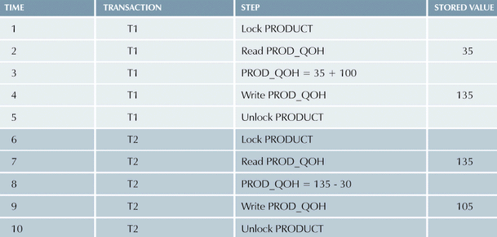
Example of Binary Lock Table
Table 9.10
Notes:
31

Slide 47
Shared/Exclusive Locks
Exclusive
  Exists when access reserved for locking transaction
  Used when potential for conflict exists
  Issued when transaction wants to update unlocked data

Slide 48
Shared/Exclusive Locks
Shared
  Exists when concurrent transactions granted READ access
  Produces no conflict for read-only transactions
  Issued when transaction wants to read and exclusive lock not held on item

Slide 49
Shared/Exclusive Locks
Shared
Shared locks

Slide 50
Problems with Locking
  Transaction schedule may not be serializable
    Managed through two-phase locking
  Schedule may create deadlocks
  Both problems can be managed by using deadlock detection and prevention techniques

Slide 51
Two-Phase Locking
Defines how transactions acquire and relinquish locks
Two-phase locking guarantees serializable, but not prevent deadlock.
It has two phases:
  Growing phase
  Shrinking phase

Slide 52
Two-Phase Locking
Growing phase:
  in which a transaction acquires all the required locks without unclocking any data;
  once all locks have been acquired, the transaction is in its locks point.

Slide 53
Two-Phase Locking
Shrinking phase:
  In which a transaction releases all locks and can not obtain any lock.
Two-phase locking is governed by the following rules
Governing rules
  Two transactions cannot have conflicting locks
  unlock operation can not precede a lock operation in the same transaction
  Data are affected after all locks are obtained

Slide 54
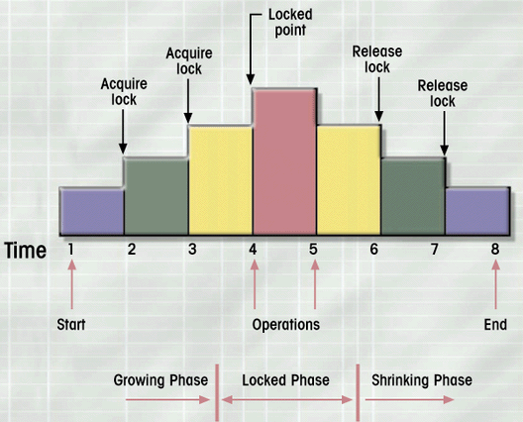
Two-Phase Locking Protocol
Transaction acquires two locks

Slide 55
Deadlocks
Occurs when two transactions wait for each other to unlock data
T1 ---- access data items X and Y
T2 ---- access data items Y and X
If T1 has not unlocked data items, T2 can not starts.
If T2 ha not unlocked data items t1 can not continue.

Slide 56
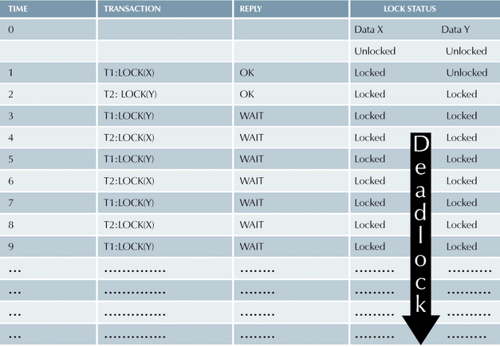
deadly embrace

Slide 57
Control techniques
  Deadlock prevention:
    abort new lock, if there is the possible that deadlock can occur
    Rollback and all locks obtained by the transaction are released
    Reschedule transaction
  Deadlock detection:
    DBMS periodically tests the database fro deadlocks
    If it happens, abort, rollback and restart, others continue

Slide 58
Control techniques
  Deadlock avoidance
    Transaction obtains all the locks needed before it can be executed.
Experience
  If the probability of deadlock is low, deadlock detection is recommended
  If the probability of deadlock is high, deadlock prevention is recommended.
  If response time is nit high on the system priority, deadlock avoidance might be employed

Slide 59
Database Recovery Management
Restores a database to previously consistent state
Based on the atomic transaction property
Level of backup
  Full backup
  Differential (only for modification portion)
  Transaction log (transaction )
Notes:
44

Slide 60
Causes of Database Failure
Software:
  software induced failures may be traceable to the operating system, DBMS software, application programs, or virus
Hardware
  Hardware induced failure may include memory chip errors, disk crashes, bad disk sectors, disk full errors, and so on
Notes:
44

Slide 61
Causes of Database Failure
Programming Exemption
  Application programs or end users may roll back transaction when certain conditions are defined
    Unintended keyboard error (Ctl-C)
    Withdraw from account with zero balance
Transaction
  System detects deadlocks and abort one of transactions
External
  Backups are especially important when a system suffers complete destruction due to fire, earthquake, flood, and so on
Notes:
44

Slide 62
Transaction Log
Tracks all transactions that update database
May be used by ROLLBACK command for recovering
May be used to recover from system failure
Some DBMS (ORACLE) use transaction log to recover a database forward to a current consistent state
Notes:
12

Slide 63
Transaction Log
DBMS executes transactions that modify the database, it also automatically updates the transaction log.
Notes:
12

Slide 64
Transaction Log
Transaction log stores
  Record for beginning of transaction
  Each transaction component (SQL statement)
    Operation type
    Names of objects (tables)
    Before and after values for updated fields
    Pointers to previous and next entries
  Ending (COMMIT statement) of transaction
Overhead of processing, but worth the price
Notes:
12

Slide 65
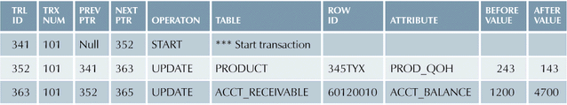
Transaction Log Example
Net 100
Net $3500
Transaction log reflects the previous two SQL UPDATE sequences
Notes:
12

